Slide 1
Fake News Classification Project Submitted by: Venkateswara Reddy D

Slide 2
Problem Statement
Business Problem Framing
The project is concerned with identifying a solution that could be used to detect and ﬁlter out sites containing fake news for purpose of helping users to avoid being lured by click bait. It is imperative that such solutions are identiﬁed as they will prove to be useful to both readers and tech companies involved in the issue.
Conceptual Background of the Domain Problem
The idea of fake news is not a novel concept. Notably, the idea has been in existence even before the emergence of the Internet as publishers used false and misleading information to further their interests. Following the advent of the web, more and more consumers began forsaking the traditional media channels used to disseminate information for online platforms. Not only does the latter alternative allow users to access a variety of publications in one sitting, but it is also more convenience and faster. The development, however, came with a redeﬁned concept of fake news as content publishers began using what has come to be commonly referred to as a clickbait.

Slide 3
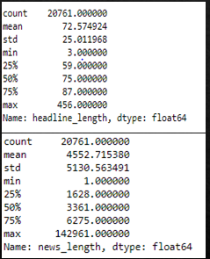
Analytical Problem Framing:
Mathematical/ Analytical Modelling of the Problem
From the above we can see that length of headlines and news and their statistical summary, so left side table is for headline and we can see that the average length of headlines is 72 and minimum length is 3 and max length is 456, and on right side table is for news, and we can see that the average is 4552, and minimum length is 1 and maximum length is 142961, so some news can be genuine, so we can’t consider them outliers.

Slide 4
Data Pre-processing Done
Converted the given text to string and lower case, so even if we get numeric values we can treat it like a string.
Removed special characters and spaces and tokenized the word using RegexpTokenizer.
Removing stop words and implemented WordNet Lemmatizer and porter stemmer to further clean the data.
Joined the filter words and created a new column as Full News and stored all the filter words into that column.
Implemented TFIDF vectorizer to convert the text into vectors.
Splitted the dataset into test train.
Implemented various Machine Learning Algorithms and compared different models in it, and selected best model.

Slide 5
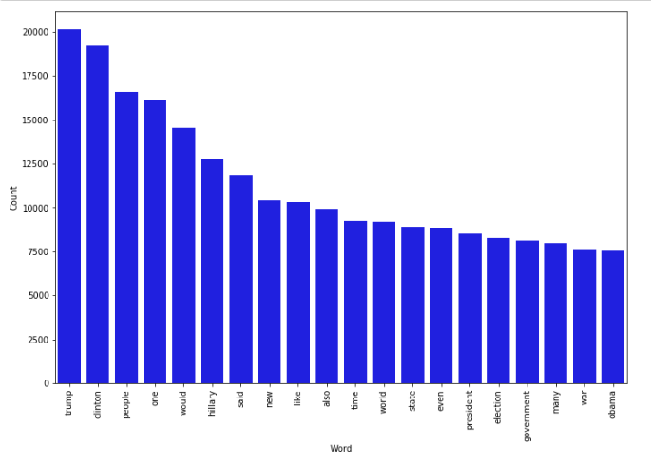
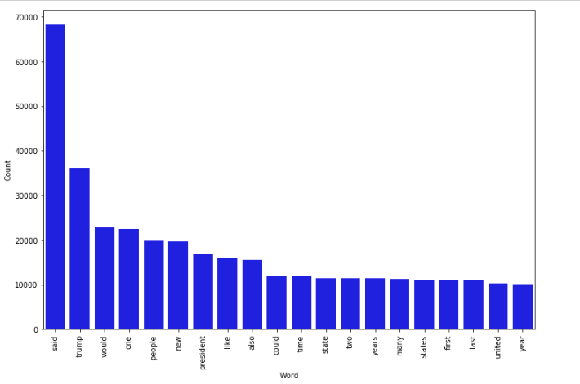
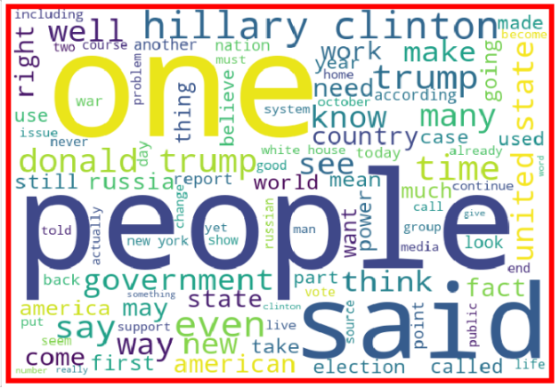
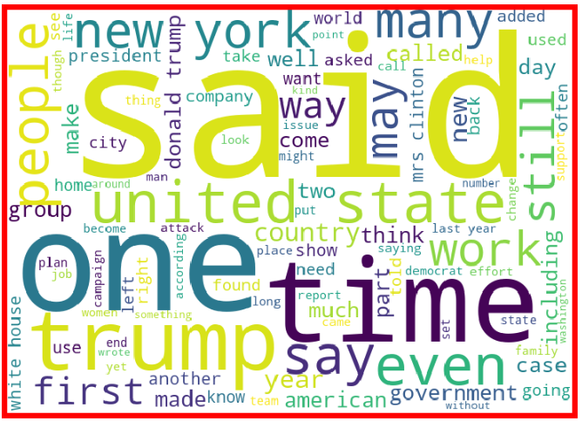
Data Inputs- Logic- Output Relationships:
Real News words Frequency
Fake News words Frequency
Real News word Cloud
Fake News word Cloud
From the above we can see that most frequent words on both labels and we can observe the words which are leading to fake new are trump, Clinton, people, one, would, etc and words which are leading to real news are said, trump, would, one, people, etc, so we can clearly see that above dataset extensively deals with news around US presidential elections between Trump and Clinton.

Slide 6
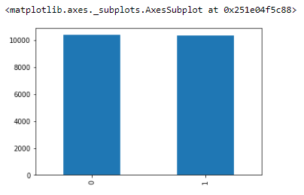
Model/s Development and Evaluation
Identification of possible problem-solving approaches
From the above we can see that the dataset is balanced which is good as it will help our model to classify more accurately, so we should expect good accuracy ssscore, and as the volume of data was also good, so was able to implement Passive Aggressive Algorithm.

Slide 7
Model/s Development and Evaluation
Testing of Identified Approaches (Algorithms)
LR=LogisticRegression()
DT=DecisionTreeClassifier()
GNB=MultinomialNB()
RFC=RandomForestClassifier()
ETC=ExtraTreesClassifier()
PAC=PassiveAggressiveClassifier()

Slide 8
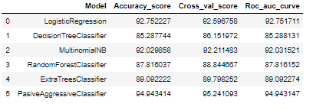
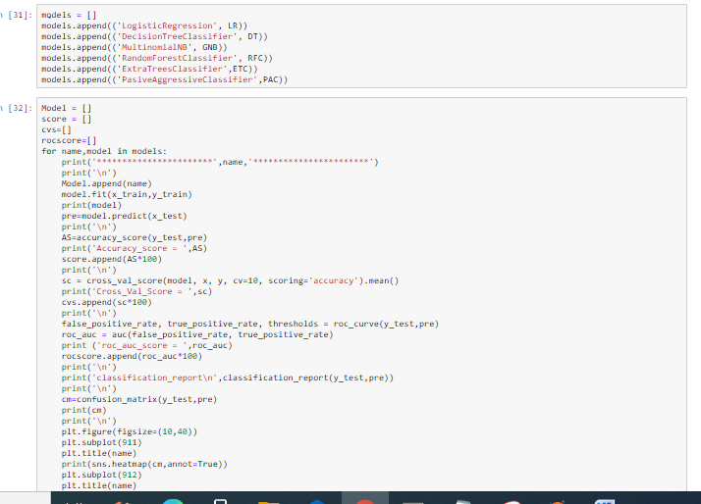
Model/s Development and Evaluation
Run and Evaluate selected models
From the above we can see that there are various models out of which we few gave good accuracy score as more than 90%, however passive aggressive algorithm performed the best then the rest of the models as we achieved 94% which was expected to perform the best out of all classifier algorithms.

Slide 9
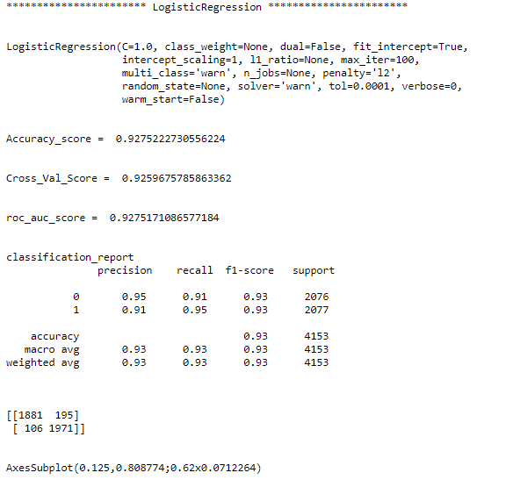
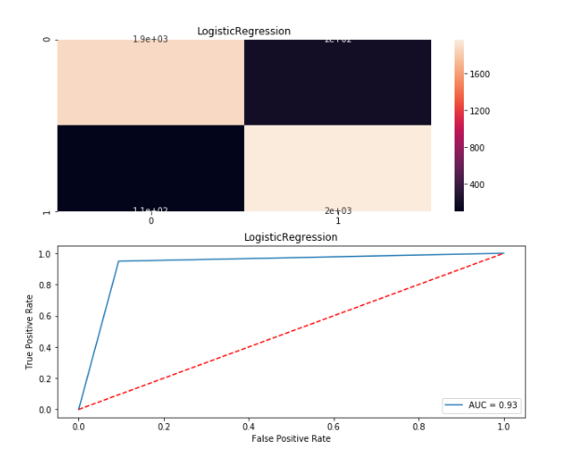
Model/s Development and Evaluation
Visualizations
Visualizations

Slide 10
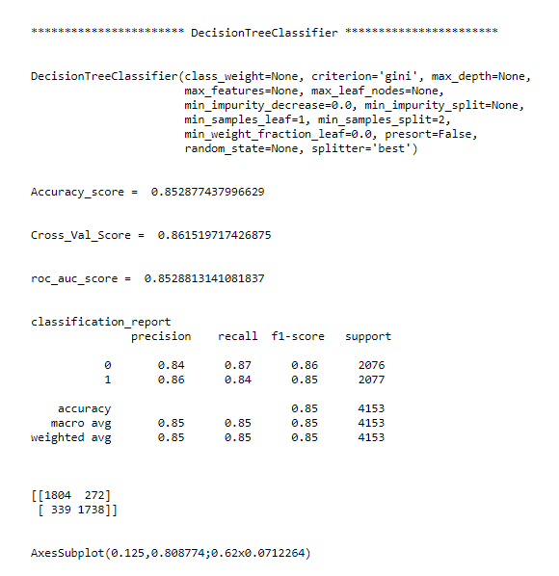
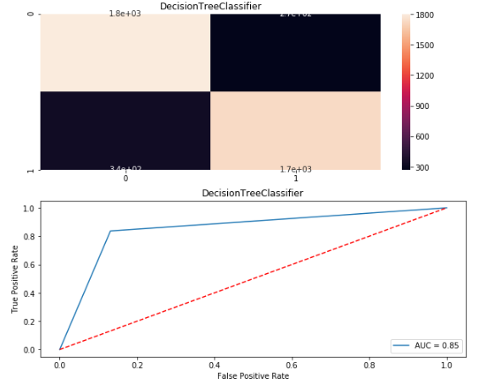
Visualizations

Slide 11
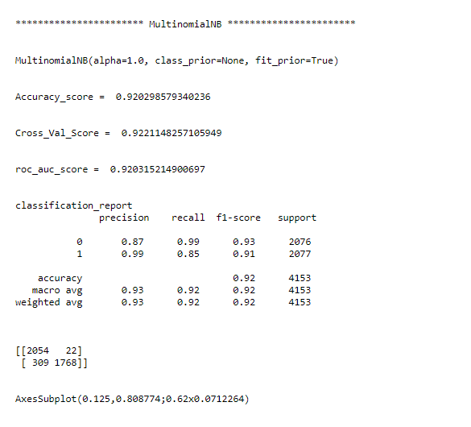
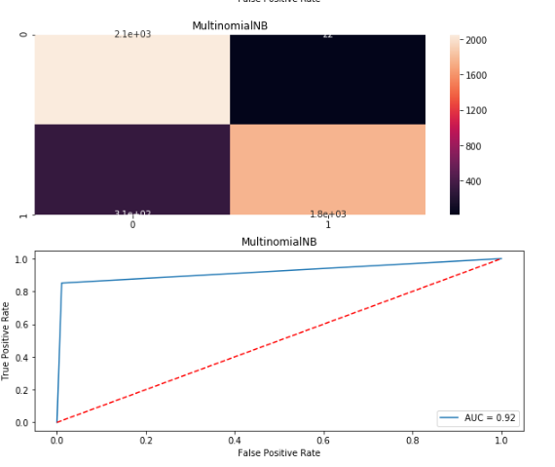
Visualizations

Slide 12
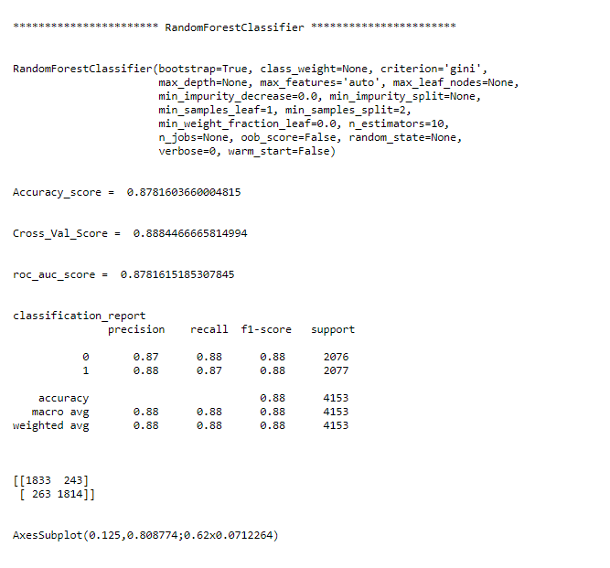
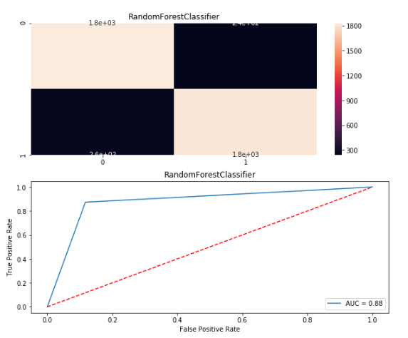
Visualizations

Slide 13
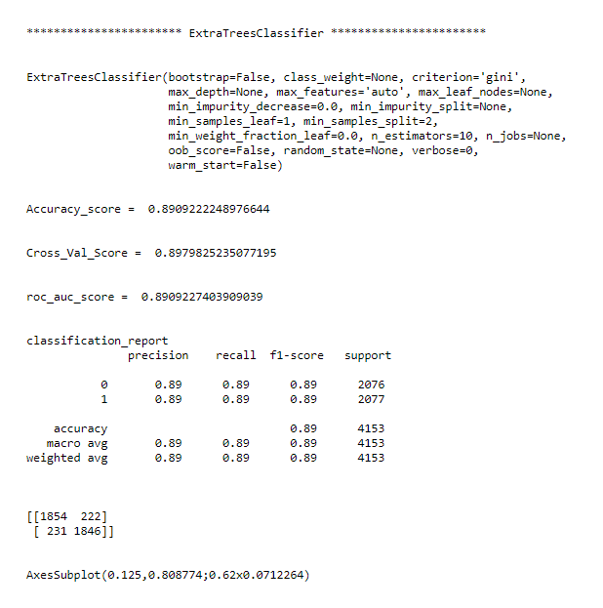
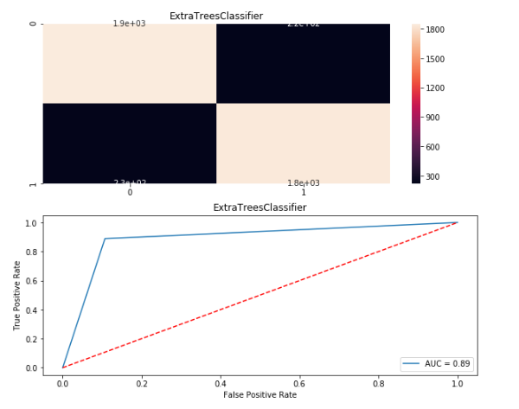
Visualizations

Slide 14
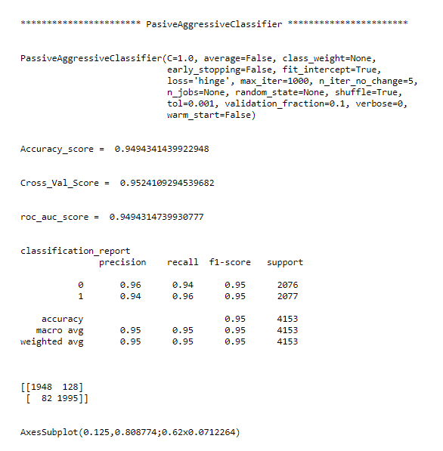
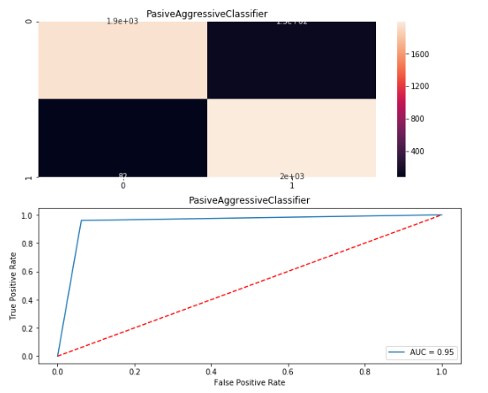
Visualizations

Slide 15
Conclusion
Key Findings and Conclusions of the Study:
From the whole evaluation we can see that the maximum number of words in fake news were regarding Trump, and Clinton and we can interpret that it was due to election campaign which was held during US presential election and we know these adverse effects of the voters which were influenced by the fake news and most of the real news had said, trump and president, and fake news which was cleared by trump’s campaign, but can hardly see any clarity or real news from the side of Clinton, and due to which the impact we already saw on election results and regarding the election advertisement and news Facebook’s CEO Mark Zuckerberg also got extensively question by congress.
So, from the words frequency chart we can clearly see that most of the news were related to US presential election between Trump and Clinton, and by implementing passive aggressive algorithms we can see that the we have achieved a good score as it calculates the errors and updates its own learning rate which makes our model more reliable.

Slide 16
Limitations of this work and Scope for Future Work
There were many limitations which training the models as I was trying to train all ensemble algorithms and SVC and KNN but they failed to provide better result and was taking a lot of time more than 72 hours to evaluate due the dataset as it was large.
Future scope of work will be definitely to implemented hyper tuning the algorithms might give better results, but as per research scholars Passive Aggressive classifier works best for fake news classification.
However, wanted to try creating training batches as we did for deep learning as it was taking a lot time to train keeping test set completely aside till we train the whole model but due to short time and lack of computational power was unable to implement.

